Slide 1


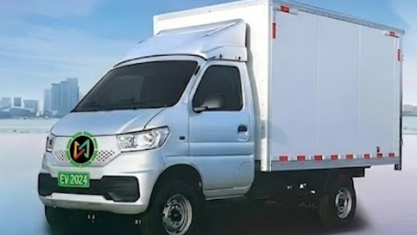






Light Commercial Vehicle 3.5T
 | Best in Class Range of 180+ KM
 | Top Speed : 80 kmph
 | Peak Power : 70 kw
 | Battery Capacity : 38.64 kwh
 | Motor Peak Torque : 230 Nm
 | Payload : 1.8 Ton
 | Gradeability : >21%
 | Storage Space: 350 Cu. Ft.

Slide 2
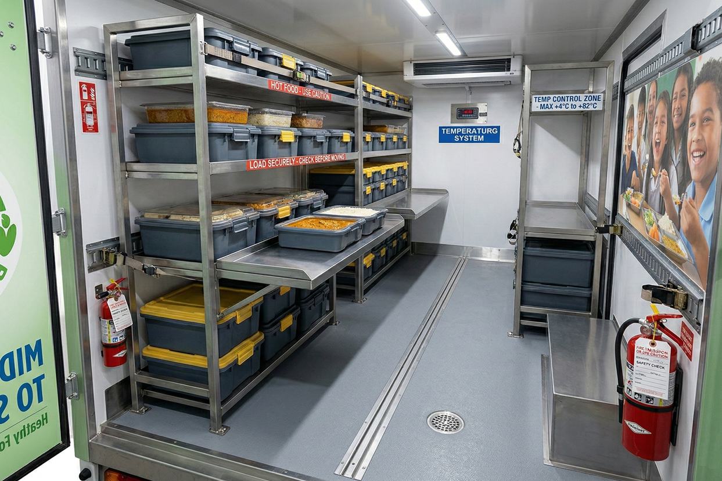
YOU DREAM WE DELIVER
Reliable Mobile Infrastructure With temperature control
for Safe & Hygiene Meal Distribution

Slide 3
Vehicle Specifications
Motor:
Charging:
S.No | Category | Specification
1 | Motor Type | PMSM
2 | Motor Cooling System | Liquid cooling
3 | Motor rated/peak power (kw) | 35/70
4 | Motor rated/peak torque (N.m) | 90/220
5 | Motor rated/peak speed (rpm) | 3714/10000
S.No | Category | Specification
1 | Fast charging socket | CCS 2
2 | Slow charging | Yes
3 | Fast charging time (hr) | 1
4 | Slow charging time (hr) | 12
Battery:
Additional Features :
S.No | Category | Specification
1 | Battery Type | LFP (Lithium Iron Phosphate)
2 | Brand | CATL / EVE
3 | Cooling Type | Air Cooling
4 | Rated total battery voltage (V) | 334.88 / 309.12
5 | Rated capacity (Ah) | 125
6 | Total battery power (kWh) | 41.86 / 38.64
S.No | Specification
1 | Regenerative Braking
2 | Anti-slide function
3 | Low speed driving warning sound
4 | Driver's seat belt is not fastened
5 | Three-point safety belt with retractor

Slide 4
Vehicle Specifications
Key Parameters:
Chassis Parameters:
S.No | Category | Specification
1 | Number of seats | D + 1
2 | Vehicle size length*width*height (mm) | 4990 * 1780 * 2050
3 | Half Dala dimensions (Inside) : (mm) | 3050 * 1690 * 360
4 | Closed container dimensions : (mm) | 3050*1690*1760
5 | Cargo Volume closed type( cub. Ft) | 320
6 | Wheelbase(mm) | 3050
7 | Ground Clearance | 182
8 | Total mass of full load GVW (kg) | 3495
9 | Kerb weight (kg) | 1440
10 | Pay Load (kg) | 1800
11 | Maximum speed (km/h) | 80 kmph
12 | Max. Grade ability (%) | 23% at full load (Stop and Go)
S.No | Category | Specification
1 | Steering type | Electric Powered steering
2 | Steering Type / Description | Type 130
3 | Steering Wheel Diameter | Ø380 mm
4 | Front suspension | Non Independent Suspension
5 | Rear suspension | Non Independent Suspension
6 | Brake form | Front Disc and Rear drum brake
7 | Brake Type | Hydraulic
8 | ABS | Yes
9 | Tire specifications | 195 R14
10 | Cab heating system | Yes
11 | Cab air conditioning system | 1.5 kw

